Slide 1

Teaching and Learning Center
Board Presentation
May 19, 2021
SEE THE IMPACT

Slide 2


Teaching and Learning Center
The Team
Professional Staff
Andrea Segraves Director, Special Projects
Nicole Shanahan Curriculum Director, Math
Kelly Tumy Curriculum Director, SS/ELAR
Dr. Colina Poullard Curriculum Director, Digital Education & Innovation
Dr. Brenda Arteaga Curriculum Director, Special Populations
Errica Dotson-Hooper Manager, TLC
The Teaching and Learning Center exists to raise the level of excellence in education and improve student achievement through a system of innovative, relevant professional learning through quality staff, valued relationships and long-term support.
This unique customized professional learning service provider boasts highly qualified content area experts who strive daily to bring value opportunity and service to our community.
Support Staff
Rosa Murillo Administrative Assistant
Lili Maldonado Administrative Assistant
Debra Harris Financial Support Assistant
SEE THE IMPACT

Slide 3

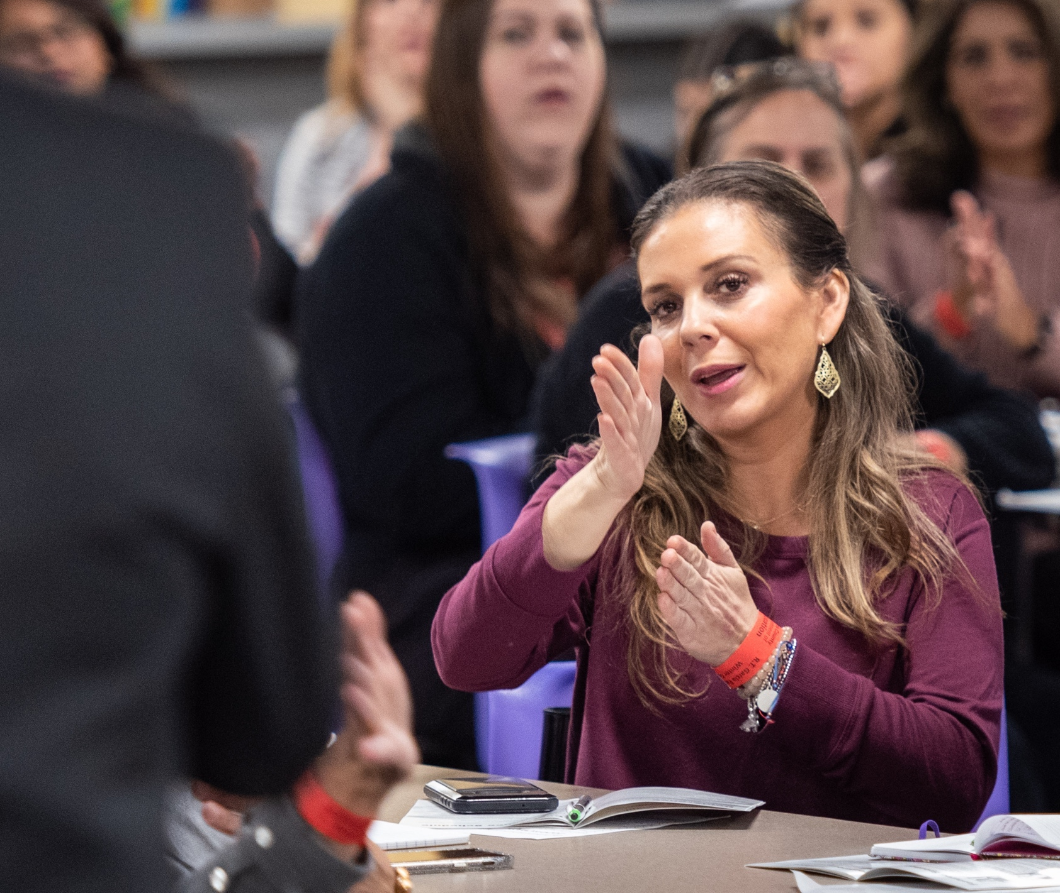
Teaching and Learning Center
Services Provided
Professional learning experiences
  Local Workshops | Conferences
  At the School | In the Classroom
Support for:
  Academic Achievement
  Equity in Education
  Social-emotional learning
  Culturally-responsive environments
  Digital Education Innovation
SEE THE IMPACT

Slide 4



Teaching and Learning Center
Specific Activities
Curriculum writing teams – 10 districts
  New Ethnic Studies Classes: Mexican American History and African American History
Expanded the hosting Moodle Learning Management System (CyFair ISD)
  Added HR and paraprofessional training (in addition to high school History, Math, Computer science)
Leadership Matters: Rising Principal Development Cohort
  Bootcamp Summer 2021
Project-Based Learning module with Bellfort PreK and Kindergarten staff
SEE THE IMPACT

Slide 5
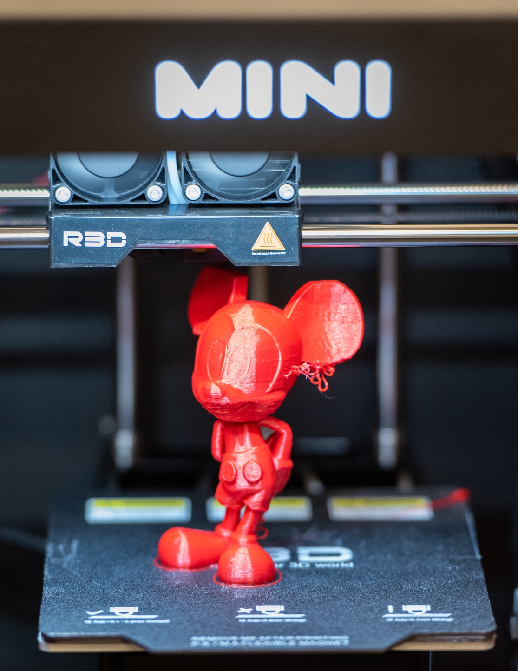
Teaching and Learning Center
Specific Activities
Mentor first-year alternative certification in collaboration with ECA (HISD)
Digital Learning Day Series
Teacher Appreciation Gifts
Fortis and High Point support for projects using 3D printers
Leadership development (Aldine ISD)
  Current/ Aspiring Principals
  Assistant Principals
Support with Dyslexia curriculum (HISD)
Introduced the Swivel, a motion-based device designed to support face to face and virtual teaching (HCDE campuses)
SEE THE IMPACT

Slide 6





Teaching and Learning Center
Specific Activities
2021/2022 Partnership with to support rising principals (Goose Creek ISD, Alief ISD, Aldine ISD and Dayton ISD)
Partnerships with The Flippen Group, Teaching Strategies, Region 6 Early Childhood Department, and Neuhaus Education Center.
Spring Leadership Academy (Spring ISD) support for framework for English Learner students
Partnered with the Adult Education Division for Digital Learning
Partnered with IT and REI for database dashboard
Increased membership in all content areas for Leadership Cohorts
Writers in the Schools partnership for Teachers, WRITE
Collaborated with CASE on a shared project with NewLit.org
SEE THE IMPACT

Slide 7
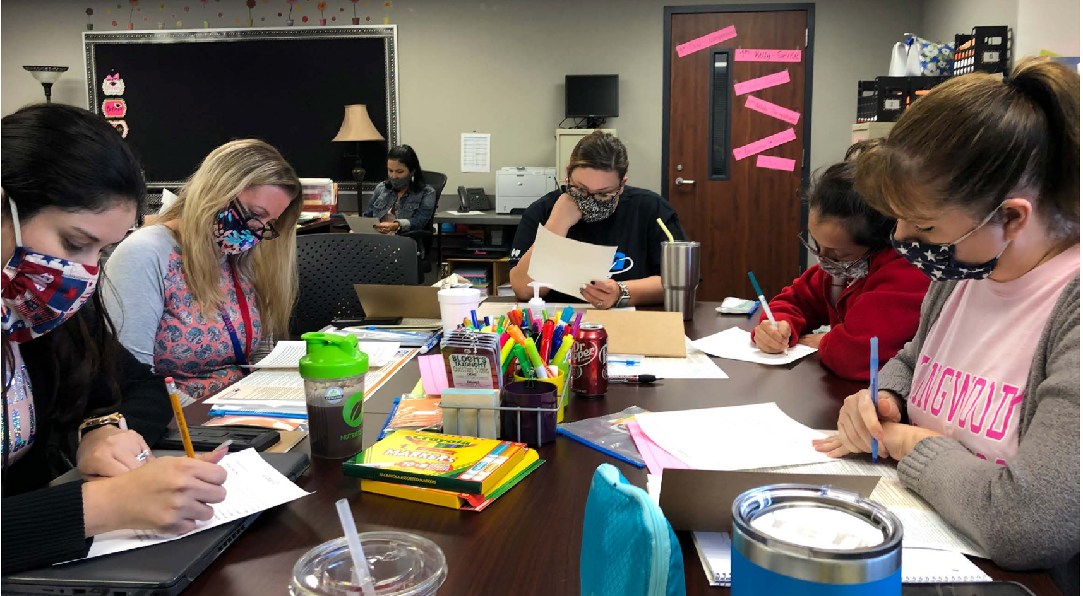
Teaching and Learning Center
Specific Activities
Supported modeling of Content Impact Coaching Model and worked to improve literacy classroom structure (New Caney ISD)
Support for 8 first year Alternative Certification Program (ACP) teachers with hybrid and in-person instruction
Implemented virtual office hours
Created “Pulse-Ox” virtual meetings (Clear Creek ISD, Spring ISD, Humble ISD and Waller ISD)

Slide 8


Teaching and Learning Center
Key Highlights
35th Year
1,212 Global Participants
  6 of 7 continents + 30 states
Presenters from LA and Australia
SEE THE IMPACT

Slide 9


Teaching and Learning Center
Key Highlights ~ Scholastic Art & Writing
8,000 Students submitted works
2400 Regional honors as Gold Key, Silver Key and Honorable Mention awards
80 National Medals and Scholarships
One student selected to join the National Student Poets Program (one of 5 nationally – first for HCDE)

Slide 10

Teaching and Learning Center
Key Highlights
Virtual conference for school leaders and teachers
770 participants
  Harris County
  Los Angeles
  Washington DC
  Las Vegas
  Atlanta
SEE THE IMPACT

Slide 11

Teaching and Learning Center
Key Highlights ~ Podcasts
The Wellness Space, a social emotional & mental health focused podcast for educators
3.4K streams
Listeners in 13 states
SEE THE IMPACT

Slide 12

Teaching and Learning Center
Current Trends ~ Looking Forward
Shift from instruction to learning | from teacher-centered to student-centered
Equity, Pedagogy and School Transformation - pulling back the curtain on implicit biases and microaggressions
Empowerment through choice - personalized learning for adult learners and students
SEE THE IMPACT
Notes:
It is vital to continually put a critical lens to our work and look beyond what others see as the leading indicator for success. Powerful qualities such as leadership, empathy, integrity, resilience, humility, creativity, and persistence cannot be measured on a standardized test, but they are critical to future success. A thriving thinking and learning culture blends these elements to not only support the achievement of all learners but to also prepare them for their future.
• Divisi

Slide 13

Teaching and Learning Center
Current Trends ~ Looking Forward
Shift from instruction to learning | from teacher-centered to student-centered
Equity, Pedagogy and School Transformation - pulling back the curtain on implicit biases and microaggressions
Empowerment through choice - personalized learning for adult learners and students
Notes:
It is vital to continually put a critical lens to our work and look beyond what others see as the leading indicator for success. Powerful qualities such as leadership, empathy, integrity, resilience, humility, creativity, and persistence cannot be measured on a standardized test, but they are critical to future success. A thriving thinking and learning culture blends these elements to not only support the achievement of all learners but to also prepare them for their future.
• Divisi

Slide 14

Teaching and Learning Center
Questions?
SEE THE IMPACT

